Slide 1
Biometrics Systems and Applications
David Zhang, csdzhang@comp.polyu.edu.hk
Yong Xu, yongxu@ymail.com

Slide 2
Outline
Introduction to Biometrics
Biometrics eve
Biometrics Emergence
Biometrics today and systems
Methods, Techniques, and Technologies
Biometrics applications
Challenges and Opportunities

Slide 3
Introduction to Biometrics
Definition:
Biometrics combines biology technology and information technology to exploit physical features or behavioral features in human body to identify a person’s identity so as to replace or enhance traditional personal identification methods.
Including: Iris, Fingerprint, Face, Palmprint, Signature, Hand Geometry, etc.
Biometrics
Physical
Behavioral
Others
(Gesture, gait, Keystroke)
Head
Hand
Signature
Voice
Face
Iris
Hand Geometry
Fingerprint
Palmprint

Slide 4
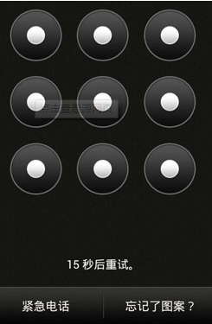

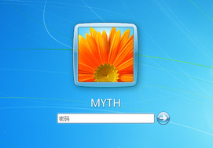
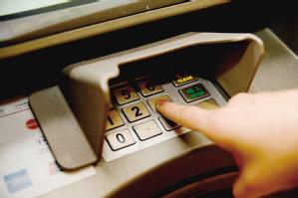
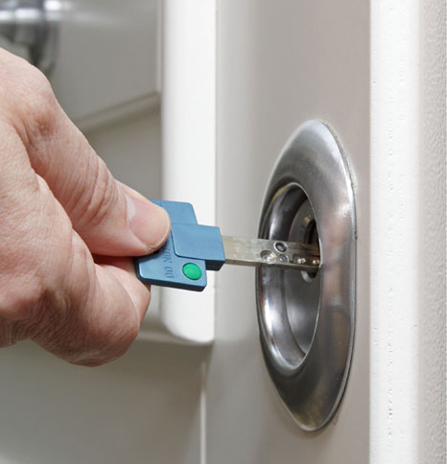
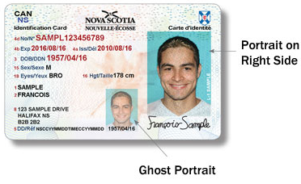
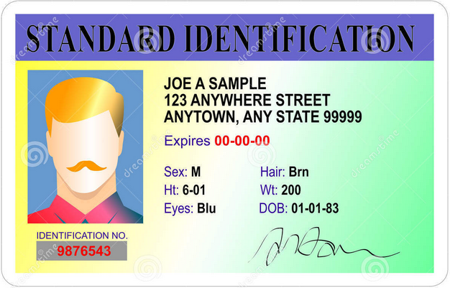
Biometrics eve
Knowledge-based personal identification
Token-based personal identification

Slide 5
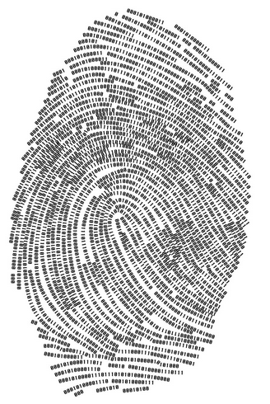
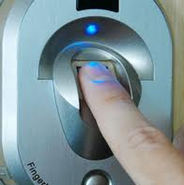
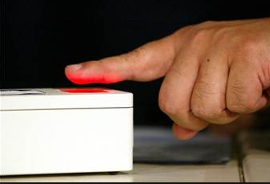
Biometrics Emergence
1.Alphonse Bertillon developed and then practiced the idea of using a number of body measurements for criminal identification in the mid-19th century.
2.People discovered the distinctiveness of the human fingerprints in the late 19th century.
3.Fingerprint identification (The earliest biometrics).

Slide 6
Biometrics today and systems
1. Two Types of Biometric Systems
❑ Identification:
One-to-many matching
Who does this fingerprint belong to?
❑ Verification:
One-to-one matching
Does this fingerprint belong to Joe Smith?
❑ Identification is a much harder problem than verification
because an identification system must perform a large number of comparisons.

Slide 7
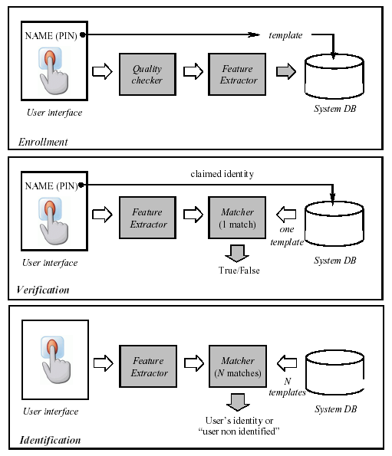

Slide 8
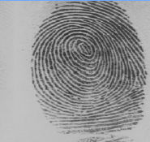
Biometrics today and systems
2. Automatic Fingerprint Identification System (AFIS)
Graphical flow like ridges present in human fingers
Formation depends on the initial conditions of the embryonic development
They are believed to be unique to each person (and each finger); acceptable in courts of law

Slide 9
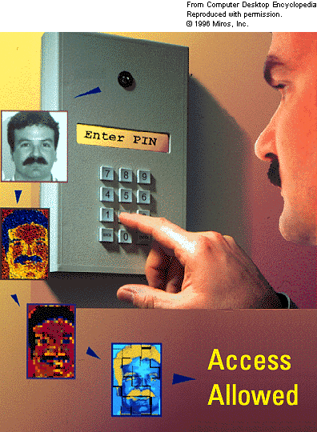
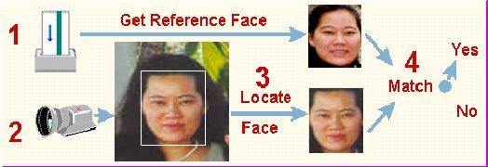
Biometrics today and systems
3. Face Identification System
Applications range from static, mug-shot verification to a dynamic, uncontrolled face identification and tracking in a cluttered background
Smart Card
Access Control

Slide 10
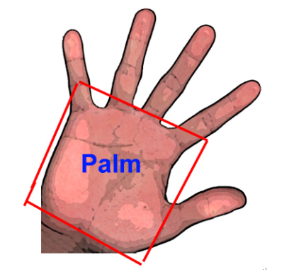
Biometrics today and systems
4. Hand and finger geometry and Palmprint identification system
Palm: The inside part of our hand from the wrist to the end of our fingers.
Palmprint: The skin patterns of a palm, composed of the physical characteristics of the skin patterns of a palm, such as lines, points, and texture.
Palmprint authentication: The way of personal authentication using unique palmprint features, either human observable or not.

Slide 11

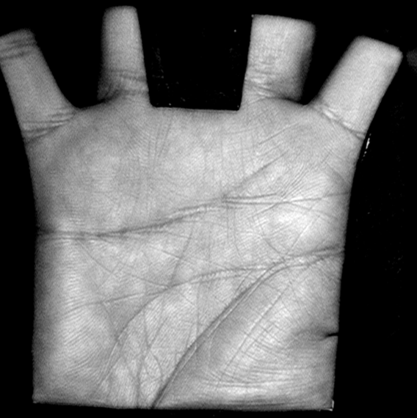
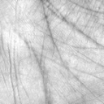
Hand and finger geometry and Palmprint identification system
Geometry features
  Finger width
  Length, width, thickness and area of a palm
Texture features
Geometry Feature
Line Features
  Principal lines
  Wrinkles
Point Features
  Minutiae point
  Delta point
  Datum point
Texture/Line Features
Singular/Minutiae Points

Slide 12
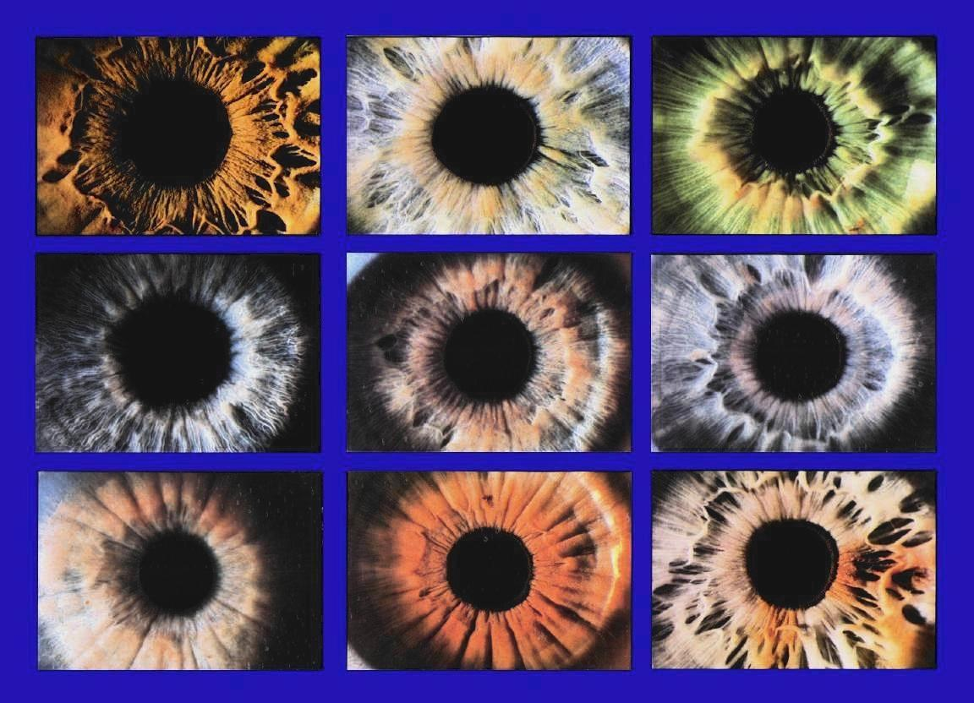
Biometrics today and systems
5. Iris identification system
❑ Current State
 Iris features can be more easily obtained than other features from eyes, like retina.
 It is shown that an iris has more details than a fingerprint. Highly detailed and unique texture will remain stable over decades of life.
❑ Feature Set
Textures with striations, contraction furrows, pits, collagenous fibers, filament, crypts (darkened areas resembling excavations), serpentine vasculature, rings, and freckles

Slide 13
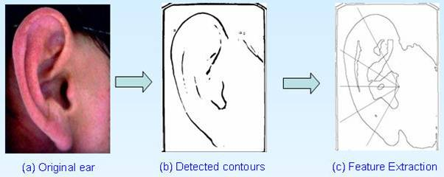
Biometrics today and systems
6. Ear identification system
Ear features for Ear based identification system:
The shape of the ear
(2) The structure of the cartilaginous tissue of the pinna
(3) The ear’s appearance in 2D intensity and 3D ear shape

Slide 14
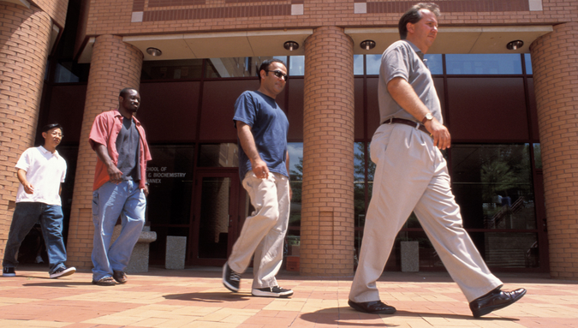
Biometrics today and systems
7. Gait identification system
Gait identification usually resort to some distinctive characteristics such as, stop length, stride length, speed, dynamic base, progression line, foot angle and hip angle.

Slide 15
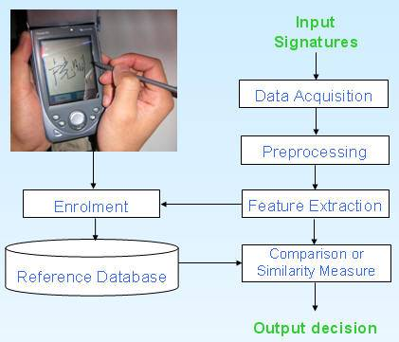
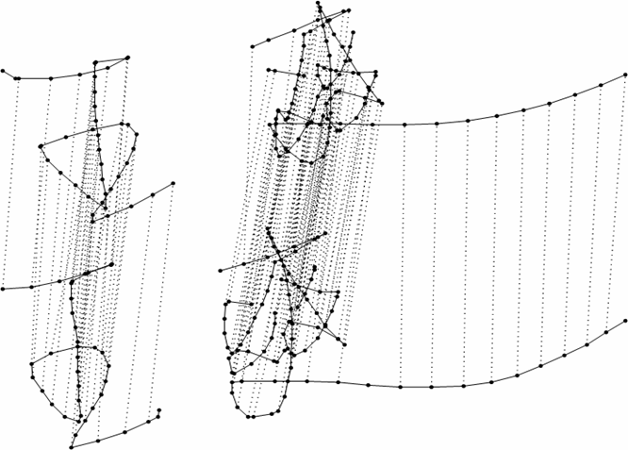
Biometrics today and systems
8. Signature identification system

Slide 16
Biometrics today and systems
9. Additional biometrics identification system
(1) Voice identification systems
(2) Keystroke identification systems
(3)Deoxyribonucleic acid (DNA) identification systems
(4) Odor identification systems
(5) Retinal scan identification systems
(6) Vascular identification systems
(7) Facial, hand and hand vein infrared thermogram identification systems

Slide 17
Methods, Techniques, and Technologies
(1) Biometric data discrimination
Recent decades have witnessed the development and prosperity of biometric data discrimination technologies. Various unsupervised/supervised, linear/nonlinear, vector/tensor discrimination technologies have been investigated and successfully applied to biometric recognition.
(2) Representation based method for identification
Representation-based classification methods (RBCM) have attracted much attention since it first emerged. RBCM first expresses the test sample as a linear combination of the training samples and then exploits the deviation between the test sample and the expression result of every class to perform classification.

Slide 18
(3) Multi- biometrics
Multi-biometric systems, which integrate information from multiple biometric traits, provide some effective means to enhance the performance and reliability of the biometric system. To combine information from individual biometric traits, there are three categories of fusion strategies, feature level fusion, matching score level fusion, and decision level fusion.

Slide 19
Main Applications of Biometrics
Forensic | Government | Commercial
Corpse Identification | National ID Card | ATM
Criminal Investigation | Driver’s License | Access Control Web Access
Parenthood Determination | Welfare Disbursement* | Cellular Phone
Missing Children | Border Crossing | e-commerce Credit Card

Slide 20
Wide applications in in industries and societies
1) Law Enforcement
2) Banking
3) Computer Systems (also known as Logical Access Control)
4) Physical Access
5) Benefit Systems
6) Immigration
7) National Identity
8) Telephone Systems
9) Time, Attendance and Monitoring

Slide 21
Research Challenges and Opportunities
1. Biometrics systems can completely replace the conventional identification systems.
2. Multi-biometrics systems can be widely used in identification systems.
3. Low cost, efficient and effective identification performance.
4. The thriving use biometrics for healthcare systems.
5.Overcoming external limitations and influences in biometrics authentication.
6. High-Resolution and the 3D Biometrics applications.
7. Exploring new areas of biometric security.

